Slide 1
Sharing Resources
Lesson 6

Slide 2
Objectives
Manage NTFS and share permissions
Determine effective permissions
Configure Windows printing
Notes:
Outline the material you are going to cover in this lesson. Do not go into detail as each of these points will be expanded on in the lesson. You may also want to mention the Technology Skills that are being covered for the Certification exam also.

Slide 3
Managing Permissions
NTFS permissions
Share permissions
Registry permissions
Active Directory permissions
Notes:
Discuss the concept of permissions in general. Talk about the different system entities that need to be secured with permissions. Briefly describe each type of permission on the slide.

Slide 4
Windows Permission Architecture
Access Control List (ACL)
Access Control Entries (ACEs)
Security principal
Permission
ACL
Sales – Read
Managers – Full Control
JSmith – Deny Access
Folder
ACEs
Security Principal
Notes:
Describe each element of the Windows Permission Architecture.

Slide 5
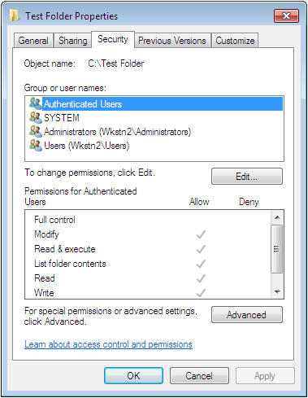
The Security Tab
ACEs
ACL
Notes:
Use the screen shot on the slide to show the Security Principals and the permissions.

Slide 6
Copying and Moving NTFS FIles
Copy file to a folder within NTFS volume, inherits folder permissions
Copy file to a folder between NTFS volumes, inherits folder permissions
Move file to a folder between NTFS volumes, inherits folder permissions
Move file to a folder within NTFS volume, retain permissions regardless what permissions the folder may have
Copy or move file from FAT32 to NTFS volume, inherits folder permissions
Notes:
Describe what happens when you Move or Copy a file to a folder on the same NTFS volume or to a different NTFS volume.

Slide 7
Effective Permissions
The combination of Allow permissions and Deny permissions for each security principal:
Allow permissions are cumulative. (from one or more sources)
Deny permissions override Allow permissions.
Explicit permissions take precedence over inherited permissions.
Notes:
Discuss Effective Permissions. It is helpful to go over several examples to show students how the permissions work.

Slide 8
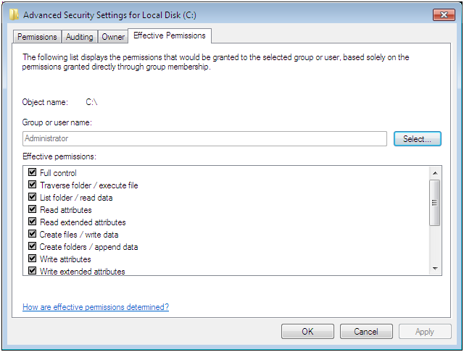
Effective Permissions Tab
Notes:
Explain how to use this tab.

Slide 9
Managing NTFS Permissions
Security Descriptor
Folder – Secured Object
ACL
Sales – Read
Managers – Full Control
JSmith – Deny Access
Access Token
Jsmith
Groups:
Sales
SID
Lesson 6 p190, second last paragraph
Notes:
Explain SIDs and Access Tokens and what happens when a user logs on and then accesses a secured resource.

Slide 10
NTFS Standard Permissions – Full Control
Folder
File
Modify the folder permissions.
Take ownership of the folder.
Delete subfolders and files contained in the folder.
Perform all actions associated with all of the other NTFS folder permissions.
Modify the file permissions.
Take ownership of the file.
Perform all actions associated with all of the other NTFS file permissions.
Notes:
On the next several slides, explain what each Standard permission allows a Security Principal to do.

Slide 11
NTFS Standard Permissions – Modify
Folder
File
Delete the folder.
Perform all actions associated with the Write and the Read & Execute permissions.
Modify the file.
Delete the file.
Perform all actions associated with the Write and the Read & Execute permissions.

Slide 12
NTFS Standard Permissions – Read & Execute
Folder
File
Navigate through restricted folders to reach other files and folders.
Perform all actions associated with the Read and List Folder Contents permissions.
Perform all actions associated with the Read permission.
Run applications.

Slide 13
NTFS Standard Permissions – List Folder
Folder
File
View the names of the files and subfolders contained in the folder.
Not applicable

Slide 14
NTFS Standard Permissions – Read
Folder
File
See the files and subfolders contained in the folder.
View the ownership, permissions, and attributes of the folder.
Read the contents of the file.
View the ownership, permissions, and attributes of the file.

Slide 15
NTFS Standard Permissions – Write
Folder
File
Create new files and subfolders inside the folder.
Modify the folder attributes.
View the ownership and permissions of the folder.
Overwrite the file.
Modify the file attributes.
View the ownership and permissions of the file.

Slide 16
Resource Ownership
Every file and folder on an NTFS drive has an owner.
The owner always has the ability to modify the permissions, even if current permissions settings deny them access.
The owner is the person who created the file or folder.
Others with the “Take Ownership” permission can become the owner.
Notes:
Explain how the owner of the file always has access to the file/folder’s permissions so there is no way for a file or folder to become completely inaccessible, even if someone sets the permissions so that no one can access it.

Slide 17
Sharing Files and Folders
Notes:
Have a discussion about the purpose of Sharing Files and Folders to introduce the topic

Slide 18
Folder Sharing in Windows 7
Any folder sharing
Public folder sharing
Homegroup sharing
Notes:
Explain that Windows 7 provides addition methods for sharing files and folders and additional security mechanisms. Use the chart in the text book to help you describe the 3 different sharing features. Give examples of when you would use each one.

Slide 19
Sharing with Homegroups
Uses the Home network location to share the contents of libraries among all users
Automatically configured
Shares libraries in the users profiles
Can add libraries
Notes:
Describe how sharing with Homegroups works.

Slide 20
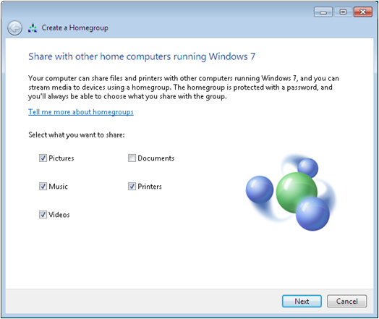
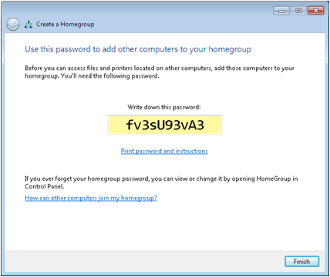
Creating a Homegroup
Notes:
Explain that when you select a Home network location, the computer attempts to find an existing homegroup. If one does not exist, the Create a Homegroup Wizard appears. If a Homegroup is detected, a Join the Homegroup Wizard appears.

Slide 21
Sharing the Public Folder
Simplest way to give clients file sharing capability (small business networking)
Network Discovery and Public Folder Sharing must be turned on
Copy files to be shared to the Public folder
Notes:
Describe how easy it is for small businesses to share information using Public Folder Sharing.

Slide 22
Working with Printers
Notes:
Briefly introduce Windows Printing. We will discuss in detail in the upcoming slides.

Slide 23
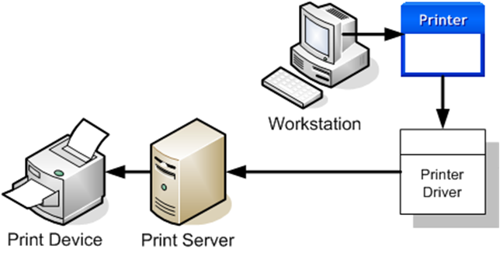
Windows Print Architecture
P 206 - P 207
Notes:
Describe each of the 4 print components. Explain how printing works.

Slide 24
Windows Printing Flexibility
Stand-alone local printing
Printer shared on the network
Print device connected directly to LAN
Create a printer pool (one print server with more than one print device)
Connect multiple printer servers to a single print device
Notes:
Describe the different ways printing can be configured on a Windows network and when each one might be used.

Slide 25
Adding a Local Printer
Most common configuration for home, small business, or workgroups
Local users can print their own jobs
Can share the printer with other network users

Slide 26
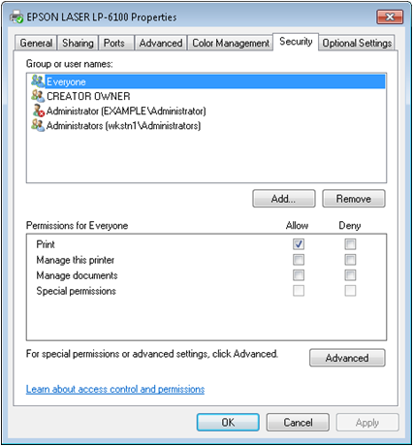
Configuring Printer Security
When password protected sharing is turned on, users must log on to the computer with a user account that has a password.
Users must have the appropriate permissions to access the printer.
Notes:
Explain the different elements on the printer properties Security tab.

Slide 27
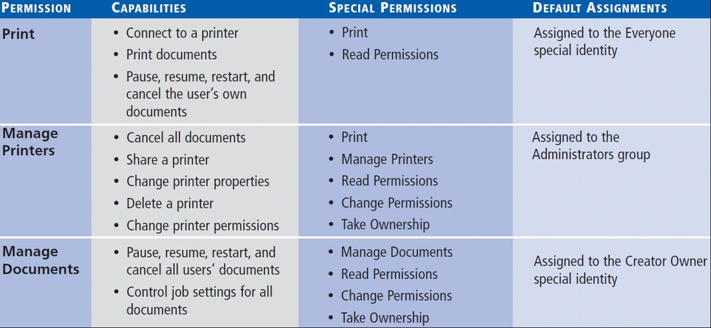
Printer Permissions
Notes:
Describe printer permissions

